Slide 1
SERVER SIDE ARCHITECTURE
SERVER SIDE HOCVALAM PROJECT
2016
Name: Vu Quang Son

Slide 2

Table of contents
Introduction to Lumen
Why choose Lumen
Server side architecture
Best Practices
Conclusion
Q & A

Slide 3

Introduction to Lumen

Slide 4
Introduction to Lumen
A new project from Laravel
A micro-framework (slimmed down version)
  Smaller
  Faster
  Leaner
  Most important functionalities (Eloquent, caching, queues, validation, routing, middleware)
  Simple but extensible
  Support Restful architecture
  Easy to upgrade into a Laravel

Slide 5

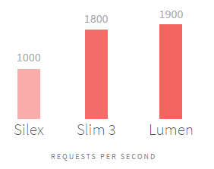
Why choose Lumen
Performance
  One of the fastest micro-frameworks available (Slim and Silex)
Perfect solution for building micro-services + fast APIs

Slide 6
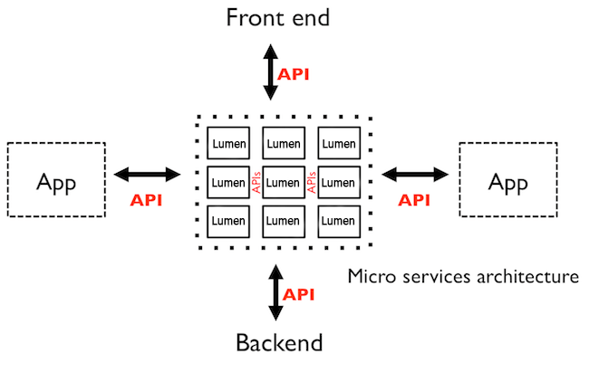
Server side architecture

Slide 7
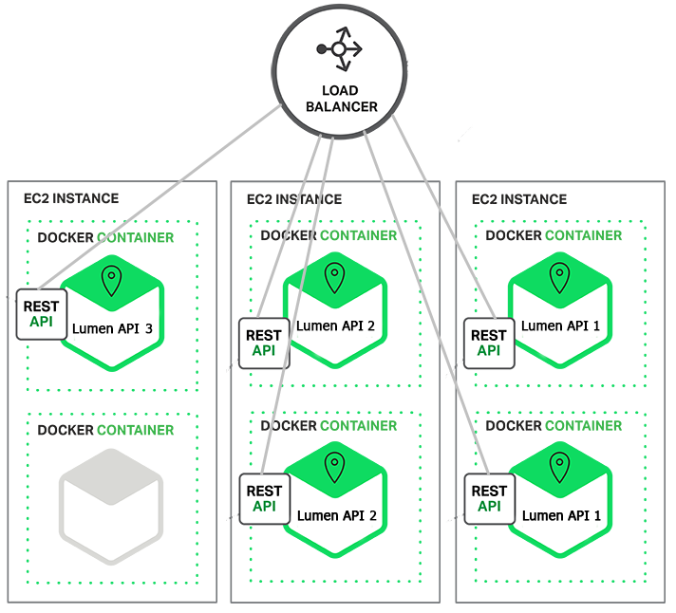

Slide 8
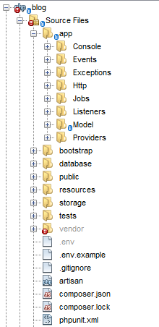

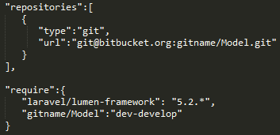
Project structure

Slide 9
Best practice
Follow http://www.laravelbestpractices.com/
  Follow latest version (Laravel 5.2)
  Dependency Management
    Composer & Packagist
  Code Style guide
  Coding practices
  Database conventions
  And more …

Slide 10
Q & A

Slide 11


